Slide 1
ONLINE INTERVIEW MANAGEMENT SYSTEM
By:
Saisree E
Vidyalakshmi D B
Yeleti Umajyothi
Mutyala Tharaka Saieswari

Slide 2
BIRD VIEW
Introduction
Flowchart
ER Diagram
Admin Module
Company Module
Applicant Module
Data Validation Module
Tools Used

Slide 3
INTRODUCTION
The proposed system is a Interview Management System.
The system will contain an admin, company and applicant module.
The system will replace the paper system into a digital system which would not require any hard copies and physical space for record keeping.
The system will serve as the centralized database for all the records in the entire interview process.
The system is easy and convenient to use.

Slide 4
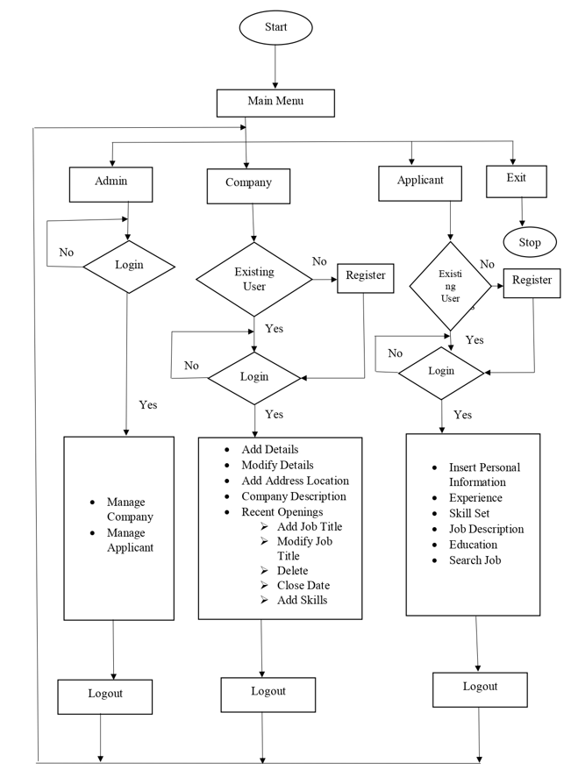
FLOWCHART

Slide 5
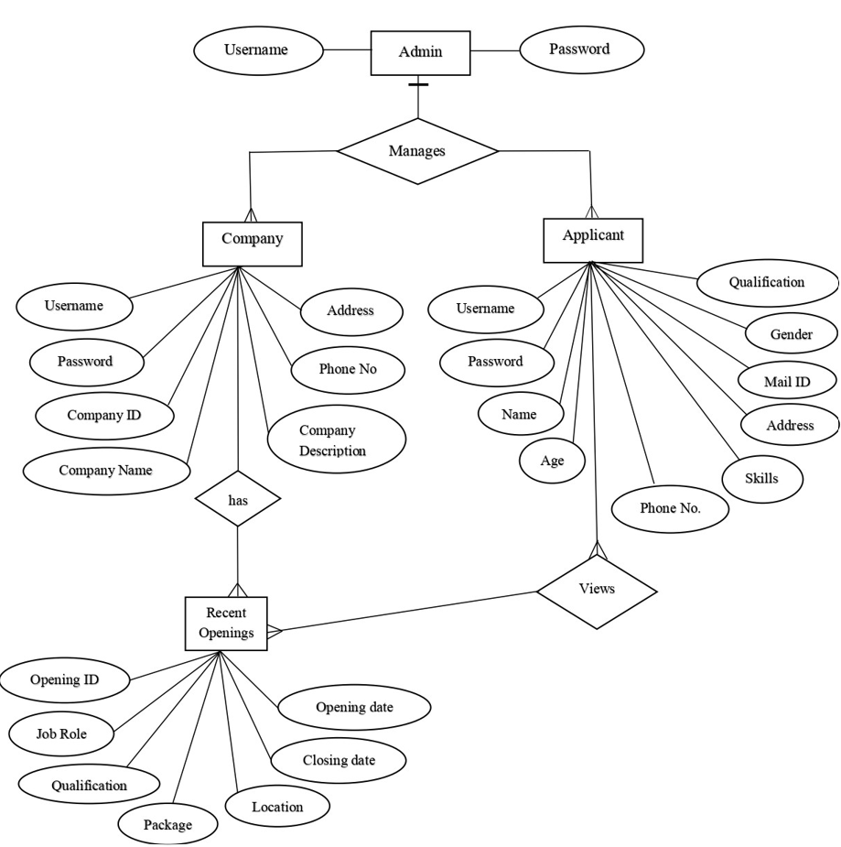
ER DIAGRAM

Slide 6
MODULES
There are 4 modules in this System
Admin Module
Company Module
Applicant Module
Data Validation Module

Slide 7
ADMIN MODULE
Admin will manage the entire interview process.
From selecting applicants to be scheduled for interview, scheduling, creating interview questions, keeping records of the interview scores and result.
Admin can view and manage applicants and companies.

Slide 8
COMPANY MODULE
In company module, companies can register if they are a new users and then login to the system.
Companies can perform the operations such as add details, modify details, add recent openings, delete the details and give description about the company in the system.
This help them select right employees for the company. They could easily manage interview processes.

Slide 9
APPLICANT MODULE
In applicant module, applicant can register if he is a new user and then login to the system by providing the credentials.
Applicant can add his personal information such as username, password, email id, phone number, education details, experience and skill set.
Applicant can view the recent openings provided by the company.
This will also be very convenient on the part of the applicants since they can now apply for a job online.

Slide 10
TOOLS USED
gcc
makefile
vim editor

Slide 11
THANK YOU

